Slide 1
The DARPA Internet Protocol Suite
Esha Desai
USC ID: 6993245898

Slide 2
Objective
Internet was needed for connection between heterogeneous networks
Need for “robust” and “reliable” connection
Use of current infrastructure of networks

Slide 3
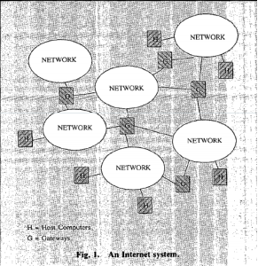
Architecture
Three main components in an Internet System:
HOSTS: They generate application specific data
GATEWAYS: They route internet datagrams to destined hosts , they are similar to routers in today’s world
NETWORKS: They switch packets between hosts
Architecture is 4 layered:
Network Layer
Internet Layer
Transport Layer
Application Layer

Slide 4
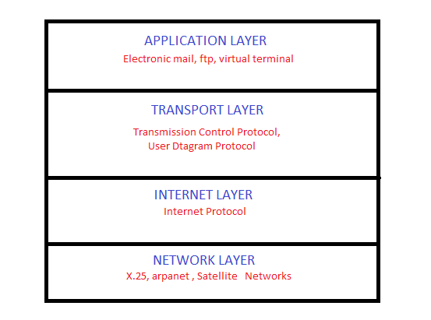
Layers of the Protocol Suite

Slide 5
Question
What was major revolution brought by the DARPA Internet Protocol Suite?
To make a unified internetworked system for reliable communication
Application on hosts need not worry about the type of network for communication
Advantages of TCP & UDP : Comparison of network measurements i.e. throughput of different types of networks by using a single system

